Slide 1
Kickstarter Data Analysis Report
By Ansh Anand, Chi-Cheong Lui, Sahand Saremi, Jason Tran, Mahumd Iqbal Halim

Slide 2
Intro to Kickstarter

Slide 3
Video ~ 1 min
expamles of successful projects

Slide 4
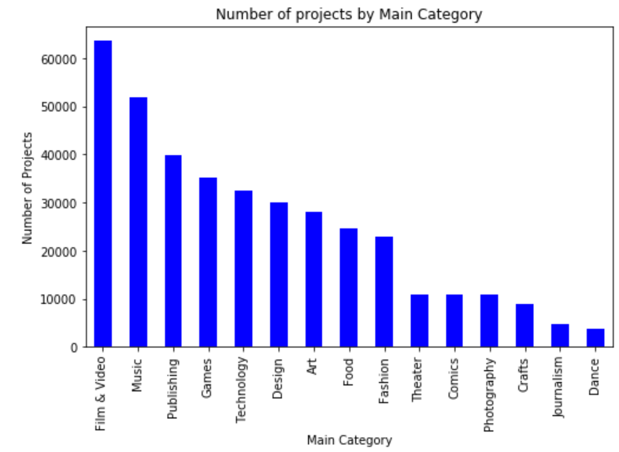
Analyzing Kickstarter Projects

Slide 5
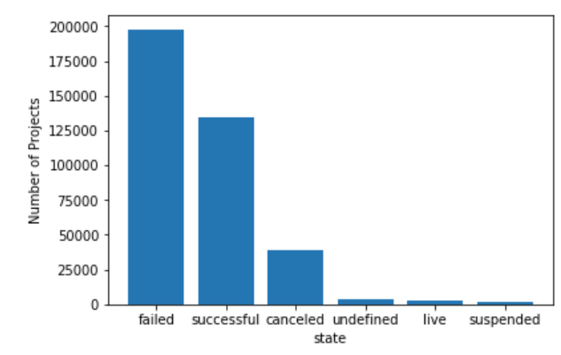

Slide 6
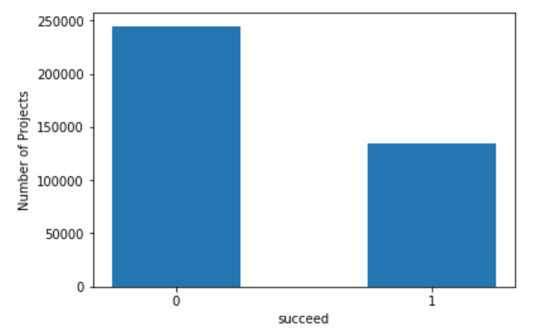

Slide 7
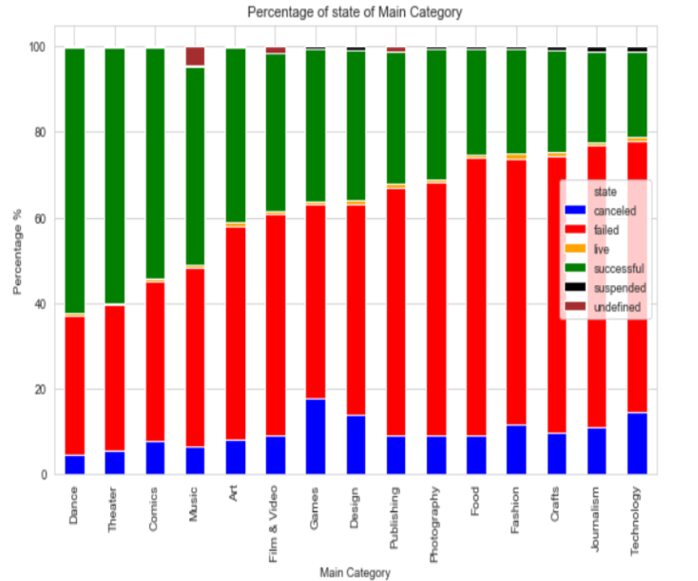

Slide 8
SUBCATEGORIES
MISSING CHARTS!

Slide 9
Video of a dance project 30 seconds

Slide 10
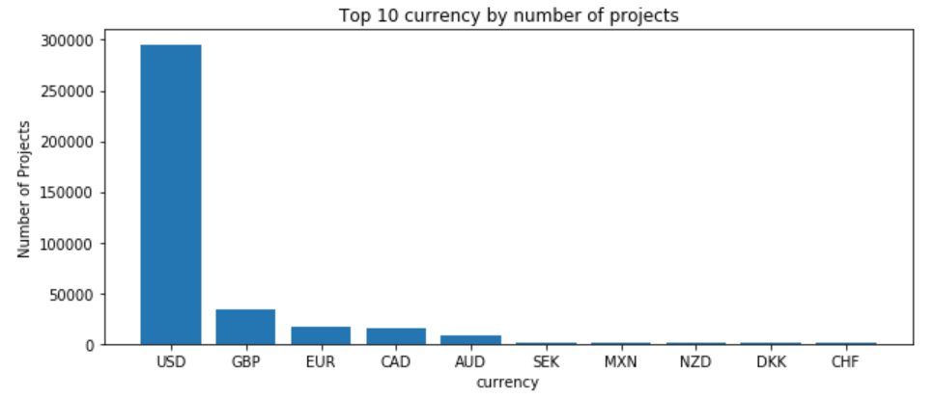
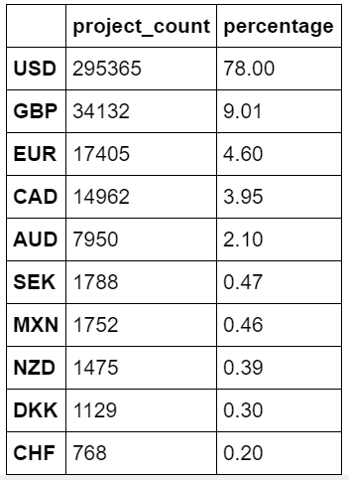

Slide 11
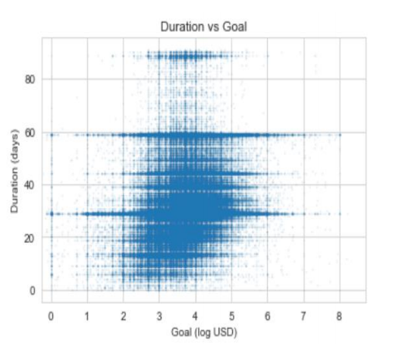

Slide 12
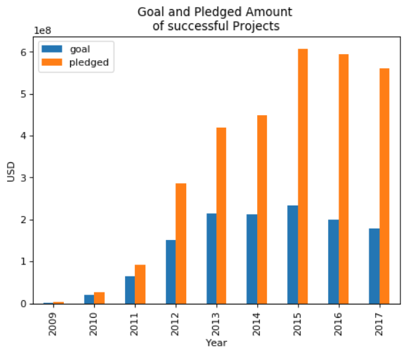

Slide 13
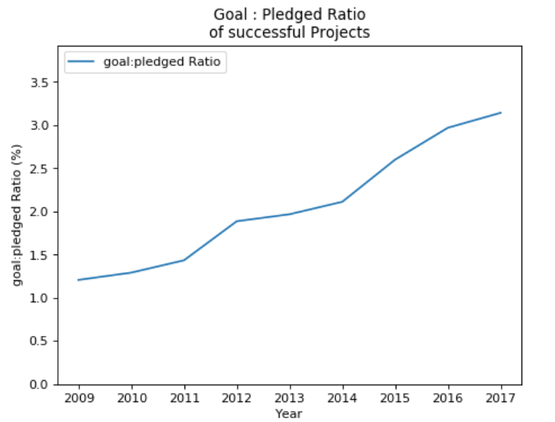

Slide 14
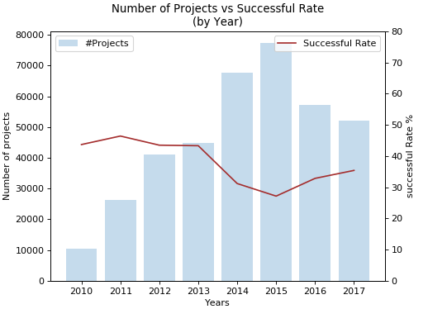

Slide 15
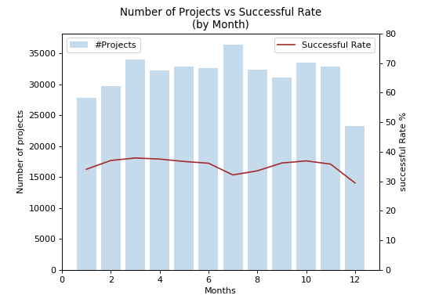

Slide 16
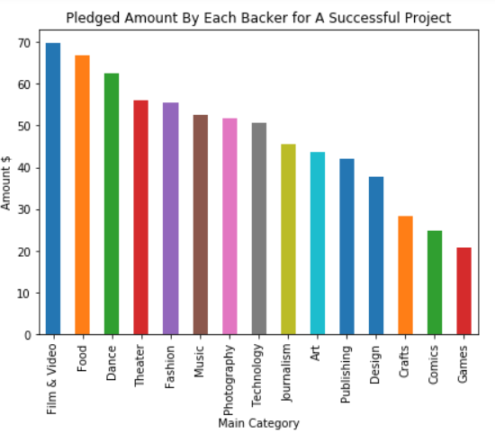

Slide 17
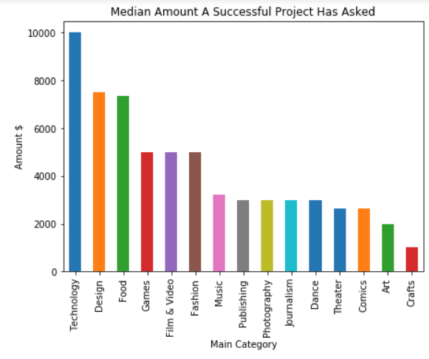

Slide 18
Conclusion

Slide 19


